Slide 1
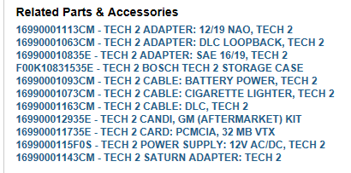
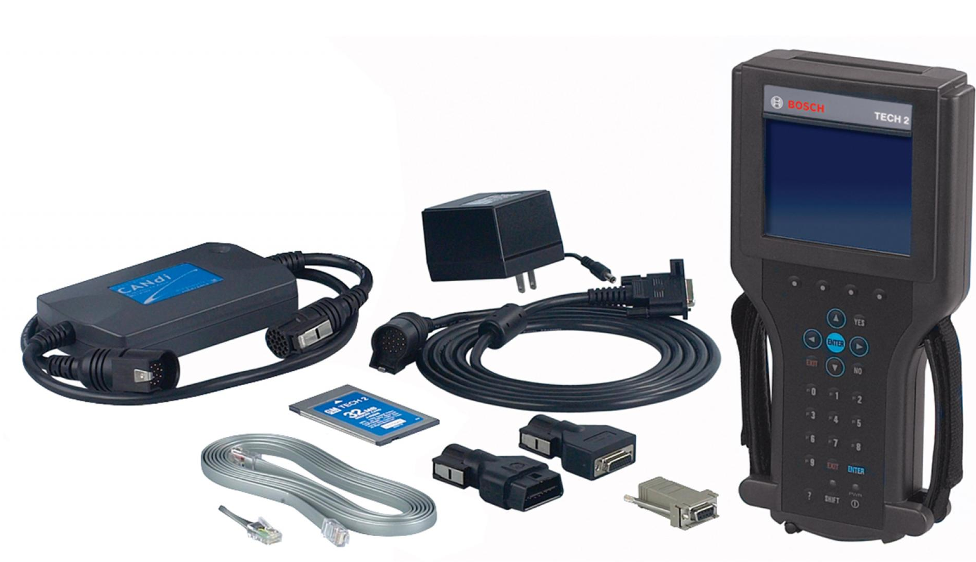
TECH2 Spare parts
Pos. Part no. Name
3000164 CANDI MODULE
3000095-A DLC CABLE
3000115 POWER SUPPLY
(not individually) MAIN BODY
3000111 RJ45 to DB9 ADPATER
3000099 NAO ADAPTER
3000098 SAE ADAPTER
3000110 RS-232 (PC) CABLE
3000112 RS-232 LOOPBACK
3000169 PCMCIA Card
4
3
2
1
10
9
7
6
5
8

