Slide 1


Saab Exterior Signs
Standard
version
PN 75/32017898 – PC sign – 750x1125mm
Aluminum signs with curvature, unilluminated
PN 75/32017663 – 2000x600mm
One piece LED (built-in) illuminated sign for Auth. Saab Service Center.
Front and back coated white Ral 9010.
SAAB in white 10 mm relief acryl . ”service" in black/white foil.
Standard
version
PN 75/32016345 – PC sign – 250x375mm
Aluminum signs with curvature, unilluminated
Mandatory for Saab PC as entrance sign
May also be applied at Saab SC
P/n 75/32019559– - 2850x900mm
One piece LED (built-in) illuminated sign for Auth. Saab Service Center. Larger version of above sign
Status per Nov 23, 2016
PN | Measure mm | In stock | Sold 2013-16
75/32017663 75/32019559 | 2000x600 2850x900 | 12 5 | 108 5
75/32017892 | 2850x900 | 0 | 6
75/32017898 | 750x1125 | 3 | 7
75/32016345 | 250x375 | 47 | 138
PN 75/32017892 – SC sign - 2850x900mm – Flat with two fluorspots to be mounted externally above sign
MUST BE ORDER VIA CUSTOMER SUPPORT, DUE TO SIZE AND PACKING REASON – SOLD OUT AND DISCONTINUED

Slide 2
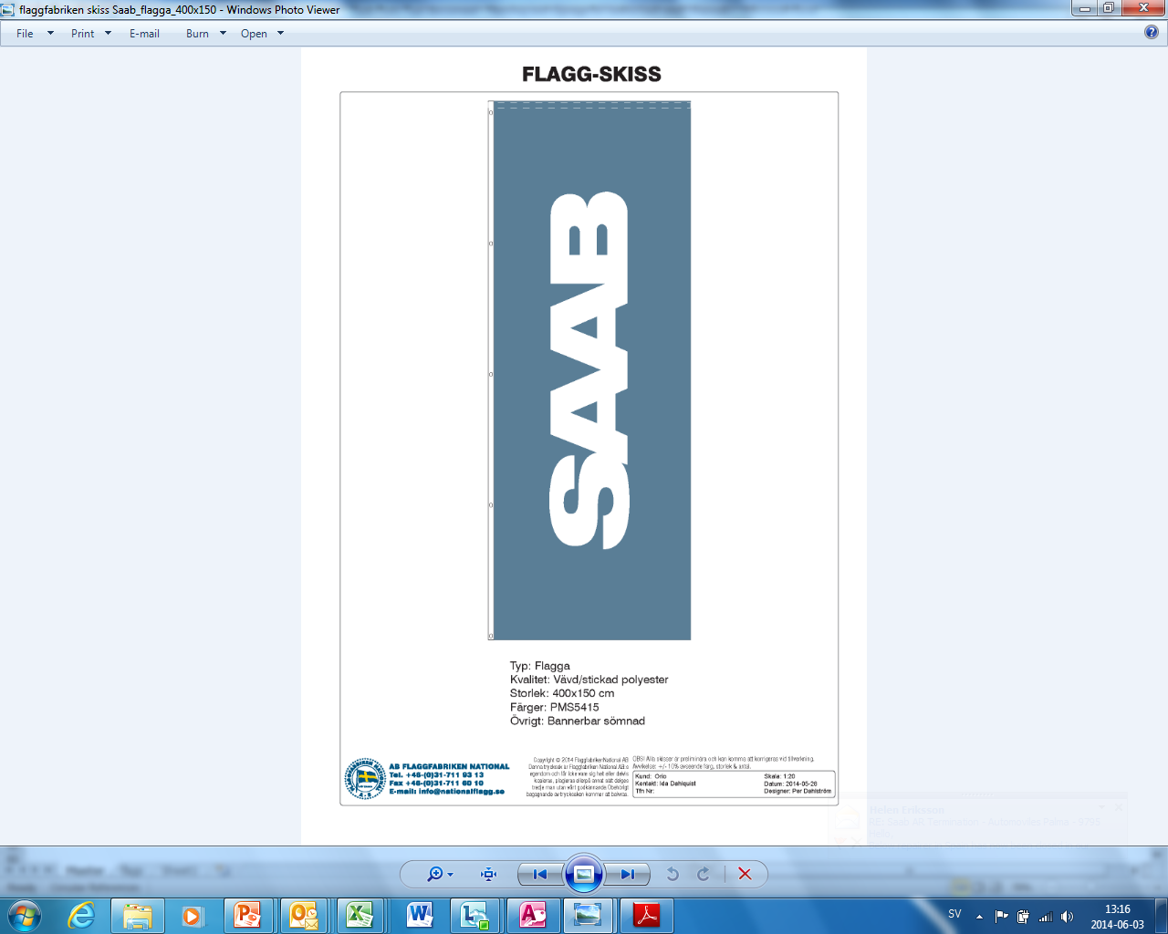
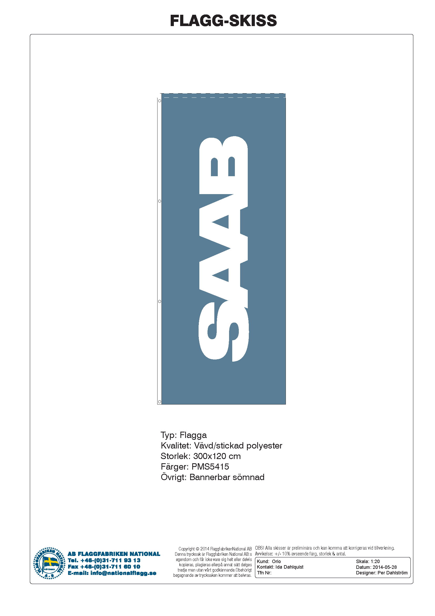

Saab Flags
PN 75/32017662
2400x1500mm
PN 75/32017893
1500x4000mm
PN 75/32017894 1200x3000mm
Status per Nov 23, 2016
PN | Measure mm | In stock | Sold 2014-16 | Markets
75/32017662 | 2400x1500 | 47 | 108 | SE, FI, NO
75/32017893 | 1500x4000 | 50 | 101 | DE, UK
75/32017894 *) | 1200x3000 | 44 | 115 | DE, SE, FI, UK

